Slide 1

WORLD POPULATION DATA ANALYSIS

Slide 2
Objective of the Analysis
Understand global population distribution and trends
Analyze population by age group, gender, continent, and year
Identify key demographic insights for decision-making

Slide 3
TOOLS USED
Microsoft Power BI, Power Query & DAX

Slide 4
DATA CLEANING
Changed the data types for columns with incorrect data types
Column names were renamed with appropriate names
The Age Group column contained a few rows with months along with age groups. These months were replaced with numbers.
Men and Women population columns were multiplied by 1000 and rounded up.
Removed unwanted columns
Pivoted men and women population columns
The two tables were appended

Slide 5
DATA MODELLING
Once done with cleaning and transformation, I closed and loaded the dataset into the model and created relationship between 3 tables (using one – to many relationship)
Fact Population as Fact table & Dim Region and Dim Age as dimensional tables

Slide 6
DATA ANALYSIS
I analyzed the data and created some DAX measures to enrich my analysis
To analyze the population data, I created several measures. These include the number of countries, the average population, and the population running total.
I created a report using charts and slicers based on the data.

Slide 7
Key Statistics Overview
Total World Population: 9.42 Billion
Number of Countries Analyzed: 201
India Population: 1.46 Billion

Slide 8
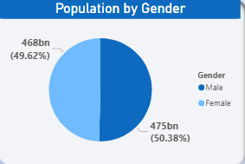
What is the composition of the male and female populations worldwide?
Globally, males and females make up almost equal shares of the population.
Although males slightly outnumber females, the overall gender composition remains largely balanced.

Slide 9
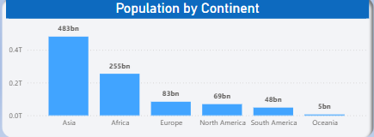
Which region is highly populated?
Among all the regions, Asia is the most populated, followed by Africa in second place, while Oceania is the least populated.

Slide 10
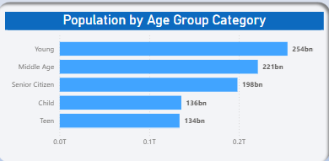
Which age group category has the highest population?
The population is evenly distributed across age groups, with Young Adults and Senior Citizens jointly representing the largest segments, each accounting for 25% of the total population.
In contrast, Teens form the smallest age group, comprising only 7% of the population.
The Children and Middle-aged groups together make up 37%, indicating a substantial share of the population in early developmental and active working-age stages.
Overall, the age distribution is relatively balanced, with no single age group overwhelmingly dominating the population

Slide 11
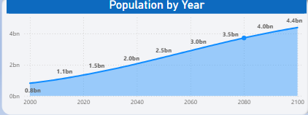
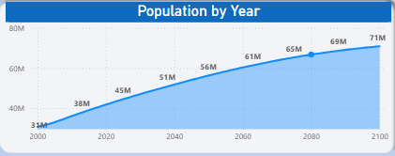
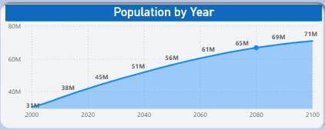
What are the population trends across all regions over the years?
Africa: shows a steady and continuous increase in population over the years. The population begins at a relatively lower level and rises consistently throughout the timeline, reaching a significantly higher level by the end of the observed period. This reflects strong and sustained population growth.
Oceania : Experiences gradual but stable population growth across the years. Starting from a low base, the population increases steadily without major fluctuations, indicating consistent and reliable growth over time.
North America : Demonstrates a consistent upward population trend throughout the period. The population grows steadily from the initial years to the end of the timeline, highlighting sustained and stable population growth in the region.
Africa
Oceania
North America

Slide 12
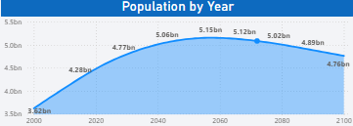
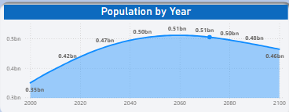
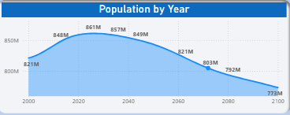
South America: Population shows a gradual increase during the early years, reaching its highest point around the middle of the timeline. After this peak, the population begins to decline steadily toward the later years, indicating a slowdown in overall growth.
Asia : Experiences a strong and steady rise in population in the initial period, peaking around the mid-point of the timeline. Following this peak, the population shows a gradual downward trend toward the end of the period, suggesting a shift toward population stabilization or decline.
Europe: Europe experiences a modest population growth initially, peaking relatively early in the timeline. This is followed by a consistent downward trend, with the decline becoming more pronounced in later years
Asia
Asia
Europe
South America
Europe

Slide 13
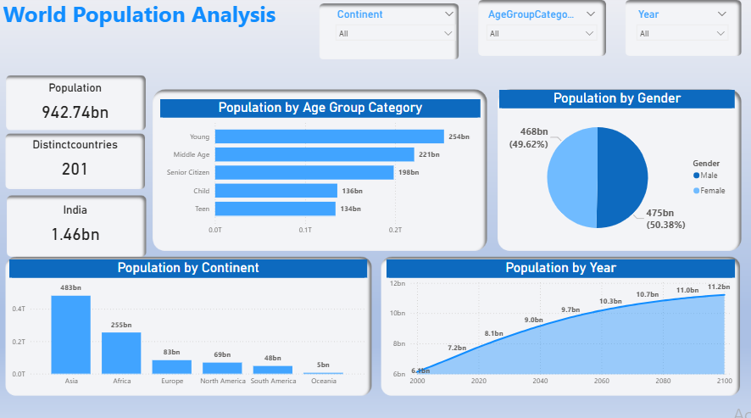

Slide 14
Key Insights
Young and middle-aged groups dominate the global population
Asia and Africa drive global population growth
Balanced gender ratio across the world
Long-term population growth trend remains positive

Slide 15
Conclusion
World population continues to grow steadily
Demographic insights support policy and planning decisions
Dashboard enables interactive and data-driven analysis
Further analysis can include country-level and forecast insights

Slide 16
THANK YOU

